Slide 1


Capgemini response to
Liberty Networks’ RFP for
Cost Transformation Initiative
March 2026

Slide 2

Disclaimer
The information shared within this proposal is solely for the purpose to respond to LN for the cost transformation RFP. This proposal shall remain the property of Capgemini UK plc. As it contains Capgemini sensitive information and supplied in strict confidence and must not be produced in whole or in part, used in tendering or for manufacturing purposes or given or communicated to any third party other than LLA and Liberty Networks team, without the prior written consent of Capgemini UK plc.
Potential saving view given in this proposal is suggestive only (based on industry experience) and pricing information in this Proposal is given as a preliminary estimate only and, along with the other information in this proposal, is not, and shall not be construed as, a formal offer for acceptance.”
Company Confidential © Capgemini 2026. All rights reserved |
2

Slide 3



Statement of Purpose
Capgemini UK plc is pleased to submit this proposal in response to your RFP for Cost Transformation Initiative. This submission reflects our clear intent to serve as your transformation partner—bringing deep telecom expertise, actionable insights, and a structured roadmap aligned with Liberty Networks’ business priorities.
Our approach is built on a comprehensive diagnosis of the ecosystem, benchmarking against local and industry peers followed by a robust Total Cost of Ownership (TCO) and business case modelling.
We take full ownership of this engagement and are committed to delivering identified priority cost transformation initiatives with accountability, transparency, and excellence across every phase—from discovery to implementation planning and support.

Slide 4
Our long-standing relationship with
Liberty ecosystem

Slide 5
Capgemini’s long‑standing partnership across the Liberty ecosystem
A proven association built over time, across OpCos and platforms
1
2
3
4
5
Depth and Duration of Association
First‑Hand Exposure to Liberty’s Technology and Vendor Landscape
Embedded Engagement Across LLA OpCos and Local Markets
Delivery Through Change While Maintaining Continuity
What this history enables for liberty networks’ cost transformation
  Capgemini has been associated with the Liberty ecosystem since the Cable & Wireless era (2007), continuing through the formation and growth of Liberty Latin America (LLA), including Liberty Networks
  The relationship spans 17+ years, evolving from application support to large‑scale modernization and transformation programs across LLA OpCos
  Hands‑on experience across Liberty’s core BSS and integration landscape, including platforms such as Liberate and Cerillion
  Direct involvement in integration modernization, API governance, and platform rationalization initiatives within the Liberty environment
  Practical understanding of vendor dependencies, legacy constraints, and architectural trade‑offs unique to the Liberty ecosystem
  Experience working with OpCo leadership and delivery teams across multiple LLA entities, including Liberty Networks, Liberty Caribbean, and Liberty Costa Rica
  Proven ability to operate within Latin American market dynamics, balancing enterprise standards with local execution realities
  Demonstrated track record of maintaining business continuity during periods of M&A‑driven change, modernization, and transformation within LLA
  Established governance, security, and compliance practices aligned to Liberty standards and operating expectations
Minimal ramp‑up and relearning, allowing immediate focus on value realization Lower execution risk across network, vendor, IT, and operational cost levers
Ability to engage as a credible, execution‑oriented partner from Day 1
Capgemini brings deep, lived knowledge of the Liberty ecosystem—built over 17+ years—and applies it
directly to deliver faster, lower‑risk cost transformation for Liberty Networks.

Slide 6
Our understanding of the RFP and Value Proposition

Slide 7




Business Objectives
Our understanding of the RFP
Our approach is centered towards addressing the key challenges & helping to consolidate, simplify & optimize Liberty Networks landscape
across Wholesale & Business Solutions.
Business Coverage
Key Challenges to be Addressed
Higher Addressable Network Costs
High costs incurred across categories (COGS, Labor & Benefits, Network, Facilities & Real Estate, Professional Fees & IT, Others ((incl. S&M, travel, etc.), Capex). Higher than industry benchmarks & best in class targets
Wholesale Solutions
1
2
Sustainable Cost Transformation & Value Realization across $250mn cost base
Vendor Spend Rationalization & Network Unit Cost Optimization
N/W Infra
Connectivity
Cybersecurity
Fragmented supplier Data & No single source of truth
Missing consolidated Vendor spend view due to missing single source of data view/ repository (contracts, contact information, invoices and key commercial terms). Large vendor landscape resulting in higher vendor spend & missing economies of scale in network costs
3
4
Rapid in year savings coupled with quick wins
AI solutions implemented & adopted
Business
Solutions
Opportunity Areas for AI solutions
Opportunity for AI solutions across a list of platforms & vendors and implement transformational AI solutions and processes.
Connectivity
Cybersecurity as a Service
Data Centers
IT Solutions
UCC
5
6
Strong KPIs, Governance office setup + Change Management
Savings‑linked fee alignment
Missing well-defined local procurement organization
A comprehensive local vendor procurement organization with well defined operating model, ways of working & forward-looking procurement view is missing in current landscape

Slide 8
Executive Summary – program on a page
A ~18 month transformation to unlock sustainable annual savings
Focused on Network, COGS, Labor, IT & Procurement optimization
Introduction of AI-enabled operations and centralized spend analytics
Shared-value, outcome-linked model with quick wins
The initiatives are classified into two categories:-
Foundational initiatives: These are the enablers for the Cost transformation
Transformation initiatives: These will drive savings
High
H
G
Foundational Initiatives – PHASE 1 | Transformation Initiatives – PHASE 2
A - Spend baseline & contract consolidation | F - Supplier renegotiations
B - Network capacity/cost analysis | G - AI-enabled network optimization
C - Labor productivity assessment | H - Opex reduction across facilities, IT, field ops
D - Capex governance framework | I - Labor & org redesign
E - AI feasibility assessment | J - Implementation of spend intelligence platform
I
Savings Potential
E
F
J
A
D
Low
B
C
Foundational
Transformation
Strategic Alignment
Implementation Roadmap
COST VIEW
  Engagement aligned to shared‑value model
  Fees linked to verified & realized savings
  Phase1 Cost – Fixed
  Phase2 Cost – Realization linked Cost (To be confirmed after Phase 1)
QUANTITATIVE BENEFITS VIEW
  Expected savings potential: (To be confirmed after Phase 1).
ROI
  Expected based on cost benchmarks for telecom cost transformations.
Phase 1
A, B, C, D, E
Phase 2
F, G, H, I, J
Q1 | Q2 – Q6

Slide 9
We bring a capability‑led cost transformation for sustainable value realization at Liberty Networks
What does this mean?
Main Advantages
Identify and prioritize value‑critical strategic and/or operational capabilities based on how LN will choose to create and deliver value in the marketplace
e.g. network capacity planning & utilization, vendor and contract management, NOC operations, field ops, and fault management
Sustainable cost reduction without compromising network reliability, resilience, or growth readiness
Improved margin profile through structurally lower run‑rate Opex and disciplined Capex
Standardized, repeatable operating model across Liberty Networks’ multi‑country footprint
Clear line of sight from cost initiatives to EBITDA and cash‑flow impact
Strategic and Operational Capabilities Identification
This approach is designed to identify quick wins in the near-term while building a sustainable transformation roadmap.
Capability Driven l Approach
Simplification & Cost Rationalization For Non Strategic/non coherent Capabilities
Systematically simplify or exit activities that do not strengthen Liberty’s target operating model across Vendor landscape and commercial terms, Network platforms, tools, and legacy technologies, overlapping operating processes, Low‑value organizational layers and roles
Ineffective Way of Simplification and Cost Cutting
Leading to sub-optimal outcomes
Traditional Approach
Across‑the‑board cuts that weaken network operations and long‑term competitiveness
Blind application of benchmarks that ignore Liberty’s unique network topology and scale
Give priority to ONLY short-term cost reduction
Savings erode as network complexity and vendor sprawl re‑emerge
Competitive position weakens as valuable activities are cut to boost short-term financials
Strategic differentiation decreases
Costs creep back over time

Slide 10
Why Capgemini is the right partner for Liberty Networks’ cost transformation
Here’s why our experience, expertise, and execution model directly match Liberty Networks’ cost transformation objectives
We know Cost Optimization
We understand Liberty Networks’ business and cost reality
Deep wholesale Telecom expertise
E2E transformation capability
Technology + Business combined
We bring proven experience in large‑scale, complex cost transformations, with a focus on structural, sustainable savings rather than short‑term cost take‑out. Our approach combines fact‑based diagnostics, prioritization of high‑impact levers, and AI-assisted disciplined execution—ensuring savings are embedded into operating models and governance, not lost over time.
We understand Liberty Networks’ infrastructure‑led wholesale business model, characterized by a network‑heavy cost base, multi‑country operations, and a complex vendor ecosystem. We recognize that value creation for Liberty requires optimizing network, vendor, and operational costs without compromising reliability, resilience, or growth readiness.
We bring deep expertise in wholesale telecom and network‑centric operating models. Our teams understand both the commercial drivers (pricing, margins, vendor economics) and the operational realities (network operations, NOC, capacity management), enabling us to identify cost opportunities that are practical, defensible, and executable.
Capgemini supports Liberty Networks end‑to‑end—from defining the cost transformation strategy and roadmap to executing and sustaining change. We combine strategy, domain expertise, change management, and implementation capability, ensuring Liberty achieves measurable outcomes, not just recommendations.
We uniquely combine business transformation expertise with deep technology capabilities—enabling Liberty Networks to use AI-assisted digital, data, and automation levers for cost transparency, simplification, and control. This ensures cost improvements are enabled by systems and data, not dependent on manual effort or one‑time interventions.
1
2
3
4
5

Slide 11
Our approach and methodology to enable this transformation

Slide 12
Illustrative Network Assessment Approach
Scoping &
Discovery
Opportunity Assessment & Recommendation
Implementation & Value Realization with Sustain & Scale
Establish full network baseline across architecture, capacity, performance, security.
Consolidate inventory and KPIs across IP/MPLS, Optical, RAN/5G, FTTH, SD‑WAN, IMS, Core, and sites.
Review OPEX, vendor contracts, lifecycle status, and site power/environment readiness.
Define future‑state across transport, 5G, optical, FTTH, edge, cloud‑native, and security layers.
Model capacity and traffic growth.
Develop automation, segmentation, and resilience enhancement strategies.
Support rollout of capacity upgrades, security improvements, automation, and CX uplift.
Deploy SLA dashboards, real‑time monitoring, and AI‑driven operations.
COMMITMENT
Highlights design gaps, high‑risk nodes, congestion zones.
Provides visibility into QoS/SLA adherence and regulatory shortfalls.
Identifies modernization blockers across IPv6, cloud‑native, automation.
Drives TCO and OPEX optimization with vendor and technology rationalization.
Enhances enterprise SLAs, VoLTE/5G KPIs, and broadband user performance.
Delivers measurable OPEX savings, energy gains, and vendor optimization.
IMPACT
Validated baseline and prioritized gap catalog.
Clear risk map across performance, capacity, security, and resilience.
Solid foundation for roadmap, investment model, and business case.
Multi‑domain blueprint and transformation roadmap.
Investment plan aligned to ROI, energy efficiency, and long‑term growth.
Uplift in core performance indicators (latency, throughput, jitter, success rates).
Strengthened security compliance and regulatory readiness.
Future‑proof, resilient, automated, and customer‑centric network.
OUTCOME
KEY DELIVERABLES:
Validated Business Case, Transformation Roadmap, Phase 2 Implementation Plan, Governance KPIs

Slide 13




Building data-driven business cases from stage 2 diagnostic and opportunity assessment
Business Requirements & Inputs
Business Case Creation
Supplier Spend Reduction
1
Alignment with Business Goals
Organization Re-design
Clear alignment between IT transformation initiatives and LN’s business objectives
2
Operational Process Improvement
3
Network Standardization
4
………………………..
Performance Baseline
5
CASE FOR CHANGE
Baseline for measuring transformation benefits and tracking ROI over time
Business Case Scoping & Setup
BASELINE ASSESSMENT
TARGET STATE COST ASSESSMENT
TRANSFORMATION INVESTMENT ASSESSMENT
SCENARIO ANALYSIS
COST BENEFIT ANALYSIS FINALIZATION
Final
Labor & Benefits Cost
1
Outcome
COGS (incl. connectivity, backhaul and software licenses)
2
Network Cost
Informed Decision Making
3
Data-driven decisions by comparing investment requirements and expected returns
Facilities & Real Estate Cost
4
Professional Fees & IT
5
Capex
6
Prioritization of Opportunities
Other expenses………….
7
Ranking & prioritization of opportunities based on ROI, strategic alignment and feasibility

Slide 14

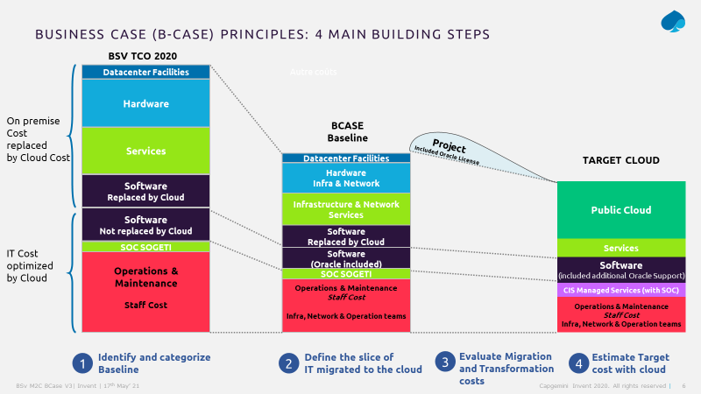

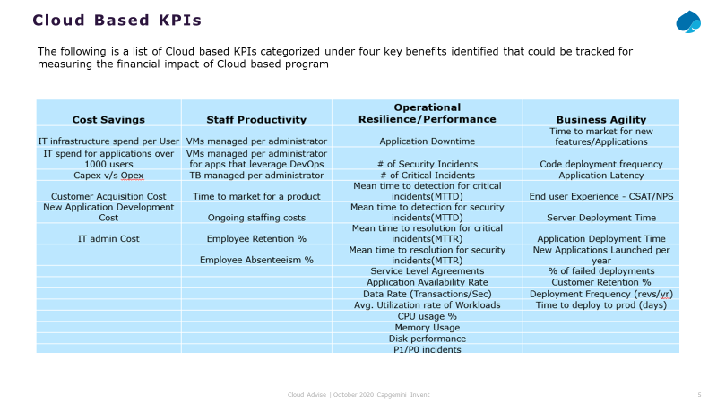

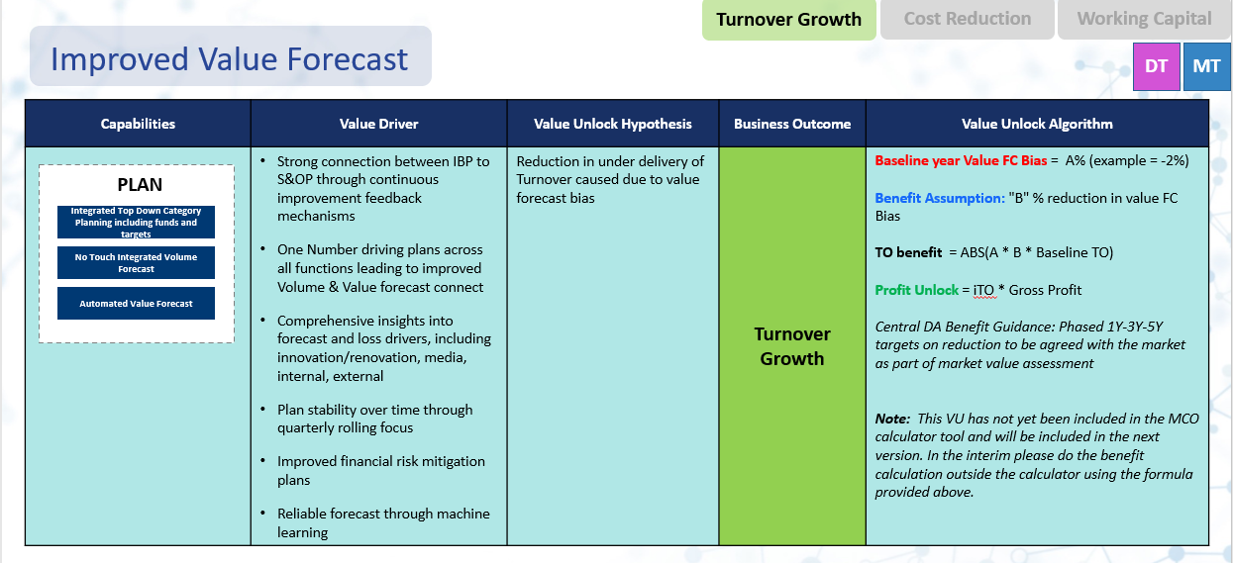

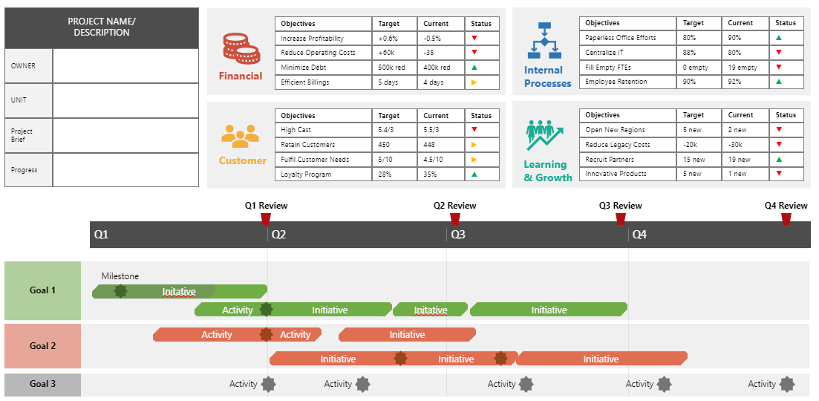



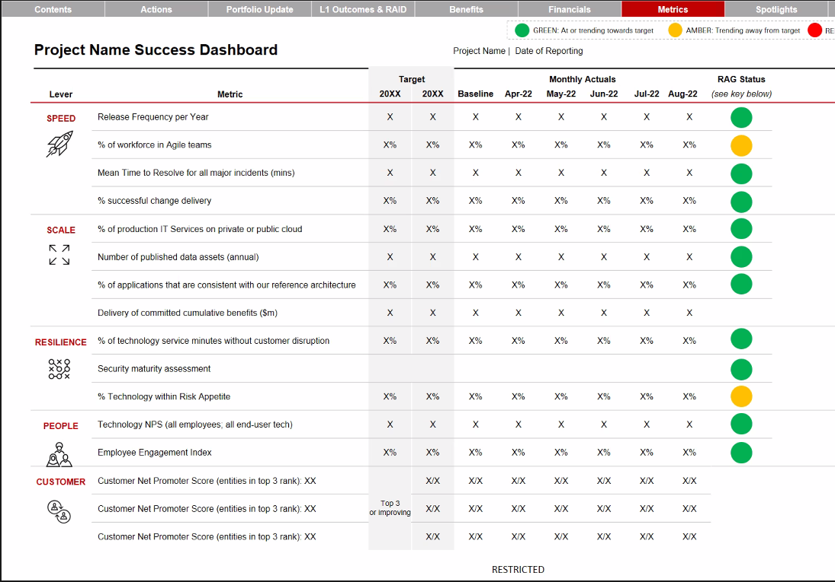
Translating implementation plans from stage 3 into the value realization model with collaborative inputs & in-depth assessment
Input
Output
Key Strategic Business Drivers
Current Pain Points
List of opportunities from Stage 1
Existing Business Cases & Assets
Transformation Roadmap
Lessons learnt from past programs
Consolidate Baseline
Based on investment portfolio & transformation roadmap
As-Is Investments
Target State Investments
Evaluation of benefits based on industry benchmarks and business cases
Current Investment Portfolio
Prioritized List of KPIs aligned to project objectives & transformation plan
Value Measurement
Framework Design
Budget
Benefits Framework created for the outlined KPIs to monitor and compare implementations
Transformation
Design Principles
VRO Design & Run Templates
to measure success of the each initiative
Baseline Assessment
Target State Assessment
Current KPIs Measured
Current Governance Model
Data Analysis Strategy
Strategic KPI Alignment
Data Analysis Strategy
to identify data sources, KPI analysis & reporting
Tools & technologies used for Finance Management
Methods for Data Visualization
Data Sources for measurement
Current Value Measurement
Governance Model Assessment
VRO Governance Model
Based on design principles & best practices to efficiently operate the VRO
Measurement Tools
Measurement Processes
Current Data Analysis
VRO Dashboard Model
To track progress and extract insights detailing actionable areas & achieved value
Key Deliverables for Benefits Validation & Framework Design
Key Deliverables for VRO Setup & Run

Slide 15




Proposed engagement timeline for stage 3
Quick wins
Long term savings
Quick wins
Stage 3 |  | Month 4 | Month 5 | ….. | ….. | …… | ….. | ….. | …… | ….. | ….. | …. | ….. | Month n
Transformation Governance (PMO/ TMO)
VRO Design
Change Management
Implementation & Value Realization (Sustain & Scale) | Lead and support execution of transformation initiatives
 | Implementation of transformational AI solutions and processes Track & report on realized savings
 | Baseline the KPIs
 | Prepare Business Case
 | Transfer capabilities & knowledge to Internal Staff
Implementation Support
VRO Setup
VRO Mobilization
Assess existing VM, KPIs/Metrics
Design VRO capability, org structure, governance & processes
Define KPI Value Hypothesis & linked financial metrics
Recommendation 1
Start & End Date depends on Implementation timelines
Recommendation 2
Recommendation 3
Quick wins
Quick wins
From Assessment + Recommendation Stage
Initiative 1 Implementation
Initiative 2 Implementation
Initiative 3 Implementation
Security Compliance
AI Pilots
Long term savings
Training & Support Model
Long term savings
Design reporting templates and dashboards
Design KPI definition card incl. baseline, perf targets & milestones
Assess data capture, automation & assessment strategy per KPI
Collect data per KPI & measure against baseline & target
Generate relevant reports and incorporate feedback

Slide 16





Illustrative view of how we track and measure ‘Value Realization’ (1/2)
Value Category
Expectation
Realisation
Observations
Strategic Goal Realisation
Growth in Strategic Focus Areas
(Convergence)
Improved Ability to Cross/Upsell
Faster TTM for Product/Offer Launches
1
Medium
High
2
Customer Enablement
Improved
Buying
Experience
Increased Digital
Enablement
Improved
Fulfillment
Reduced Need for
Repeat Visits to store/ calls
Medium
High
Sales Operations Enablement
Improved
Order
Capture
Improved
Product
Bundling
Increased Real-Time Execution
Simplified, Fully Digital Takeover Process
3
Medium
High
Zero-Touch Flows
Service Operations Enablement
Cross Channel, Real- time Customer Data Visibility
Ability to Cross/Upsell on Incoming Calls
Ability to Execute Tariff Changes in Real-Time
Increased Share of Revenue
4
Low
Medium
5
Implementation Enablement
High
High
Stable, Performant Solution
Digital Platform for B2C Growth
Skills, Knowledge & Experience for B2B Transformation

Slide 17
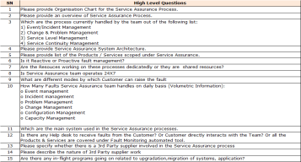
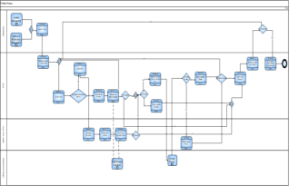
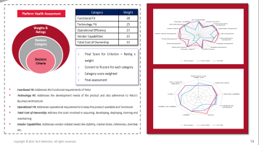
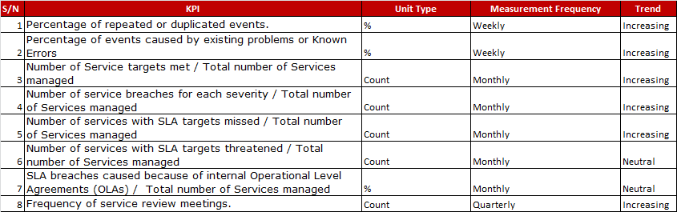
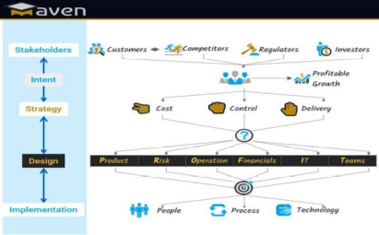
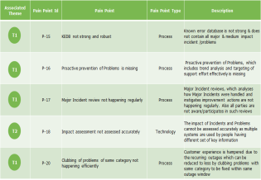
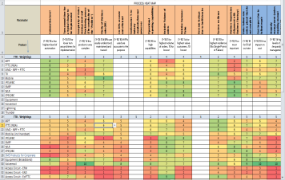
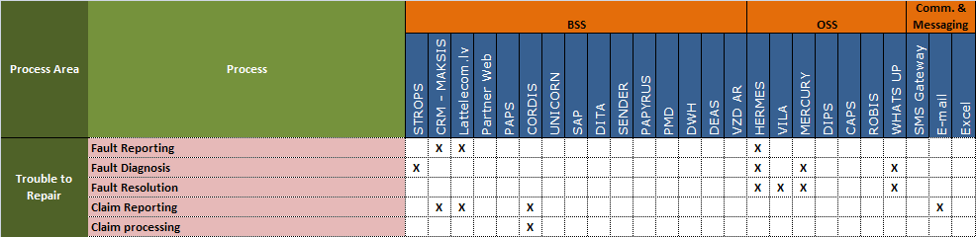
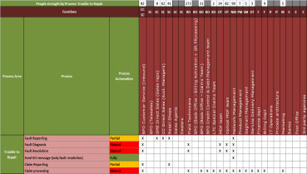
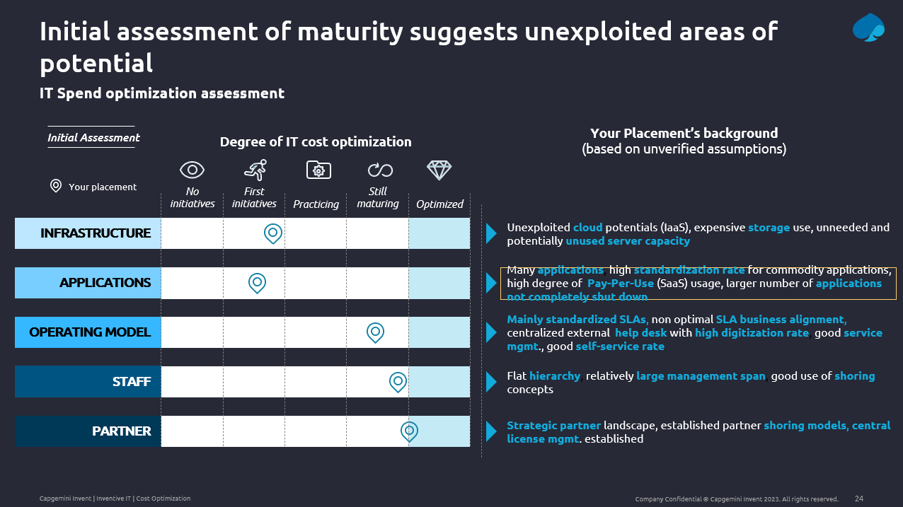
We will pick and deploy the relevant accelerator toolkit (1/2
We will pick and deploy the relevant accelerator toolkit (1/2)
SIPOC & E2E Process
Platform Health Assessment
KQI-KPI Mapping Tool
ProDiag
Discovery Questionnaire
Pre-defined questionnaire to get insights into ‘as-is’ working
Template for mapping as-is business process
Template for assessing as-is platform health
Template for qualitative as well as quantitative KPI analysis
Tool for Process Diagnostics and Operational risk assessment
As-Is Issues (Process, People, System) Capture Tool
Heat Map & Scoring Tool
Process-System Matrix
Process People Matrix
IT Cost Maturity Assessment Tool
Co-relate pain points on ‘as is’ process to indicate activities to identify hot spots for improvement
Understand system efficiency & usage
To understand the people intensity of processes
Assess and identify IT cost inefficiencies and gaps with respect to best practices
Pain points classified as process, people and system related

Slide 18
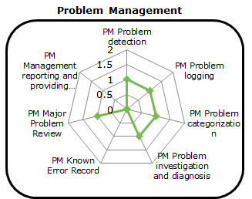
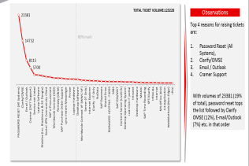
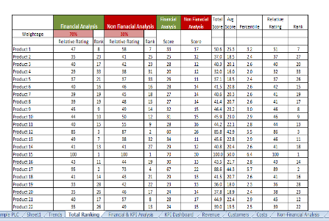
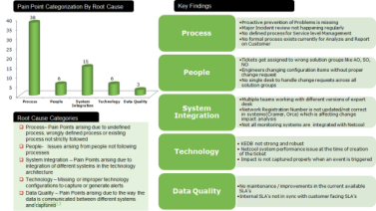
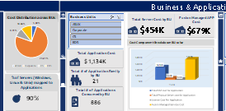
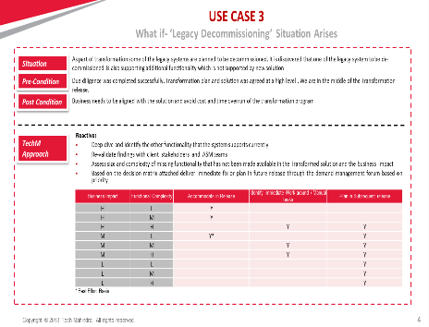
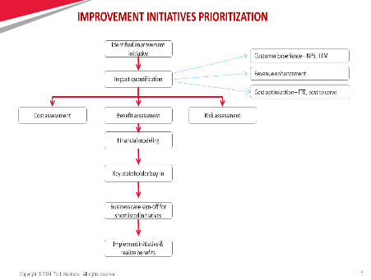
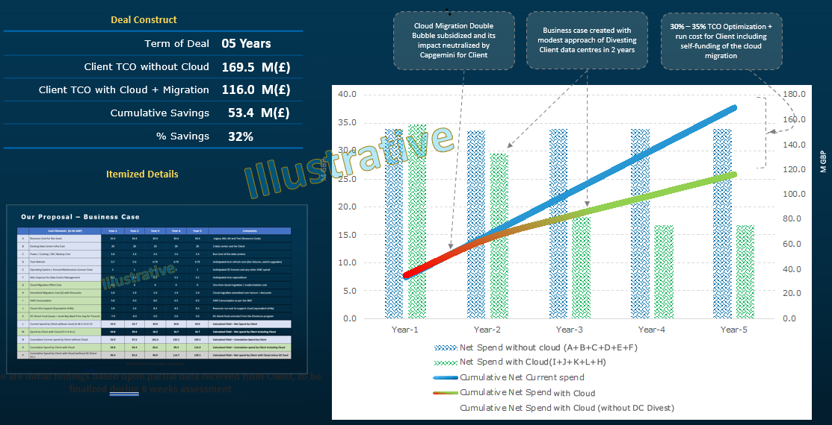
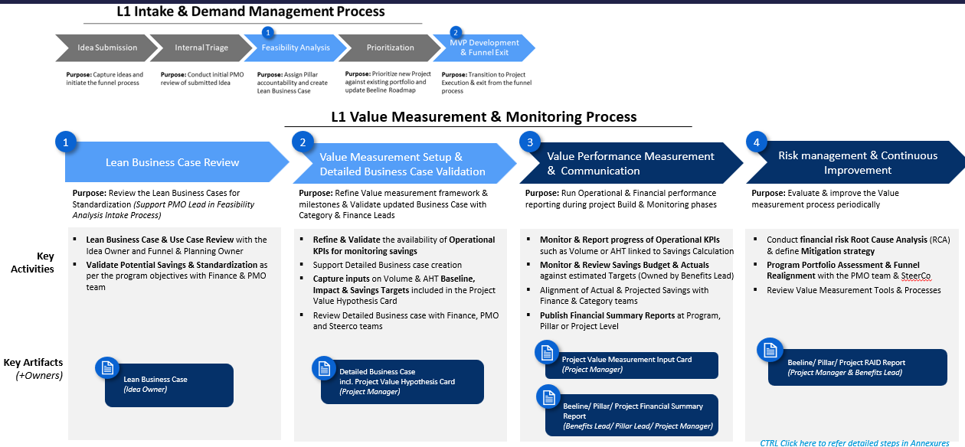
We will pick and deploy the relevant accelerator toolkit (2/2)
We will pick and deploy the relevant accelerator toolkit (2/2)
Benchmarking/League Table
Pareto Analysis
Ranking based on Financial / Non-financial analysis
Root Cause Analysis
Cost baselining tool
Benchmark processes against industry standards to discover deviation
Template for identifying top issues
Template for ranking product groups post analysis
Template for performing root causes of issues, pain points
Identify, classify and allocate costs to consuming products, services and business units
What-If use cases
Business Case Summary
Value Realization Governance and Capability Flow
Value Hypothesis
Improvement project shortlisting
Template for simulating different Business Use Cases
Template for assessing hypothesis with initial opportunity view
Template for prioritizing &shortlisting improvement projects
Template for business case with ROI and payback period
Comitology for value realization office

Slide 19
We will focus on enterprise‑wide cost transformation levers to deliver measurable, sustainable savings

Slide 20

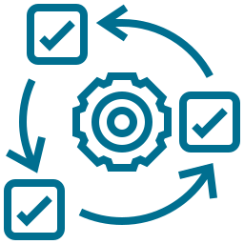





We will prioritize Liberty Networks’ transformation domains based on savings potential, ease of implementation, and impact on critical network and operating capabilities
We will pick and deploy the relevant accelerator toolkit (2/2)
Network
Business
Optimize Network spend & realize cost savings quick wins against baseline targets
Simplified single View of rationalized cost structures & operational processes to achieve spend control & match ‘Best in class ‘ targets
IT
Infrastructure
Optimization of IT cost base by reducing inefficiencies in platforms & system & AI opportunity identification
Rationalize overall infrastructure spend across software licenses, facilities & Real Estates to deliver quick in year savings
People/FTE
Partner/
Vendor
Support formalizing new procurement organization through collaboration, knowledge transfer, train the trainer programs on rationalized processes, new landscape & potential AI deployment areas
Support formalizing new procurement organization through collaboration, knowledge transfer, train the trainer programs on rationalized processes, new landscape & potential AI deployment areas
Optimization of vendor spend , reduction of vendor mgmt. costs, & process simplification to drive Network cost Transformation initiative
Optimization of vendor spend , reduction of vendor mgmt. costs, & process simplification to drive Network cost Transformation initiative

Slide 21
We are proposing a curated team construct for this engagement, comprising of global experts’ advice, subject matter experts and right-shoring location criteria

Slide 22
As part of the collaboration model, we propose a contextualized framework of how we will embed with the LN internal team and approach knowledge transfer

Slide 23

Capgemini collaboration & Knowledge Transfer approach
Start
Stop
Collaboration & Knowledge
Transfer setup
Review documentation
KT planning
Documentation of business areas processes & systems artefacts
Functional KT
Technical KT
  1. Program Preparation
  2. Validate TOM, Design
  3. Execution preparation and Impact Assessment
  4. Knowledge Transfer and Training
Create Stakeholder map
Kick Off session with stakeholders
Align on stage wise agenda
Agree on templates and deliverables
Establish governance and onboard the project team
Re-validate, Capture Operating Plan, establish design, request to process & technical documentation available & request for access
Establish & socialize an integrated project plan
Define and initiate overall collaboration strategy, communications with stakeholders
Initiate Applications access, SPOC alignment
Understand the ‘As-Is’ by scope
(e.g. Network Landscape)
Schedule & workshop plans shared with LN SMEs
Update detailed collaboration plans with LN in the governance tracker
Key risks and action plan changes, the critical path for project completion agreed and reported
Delivery resources onboarding, orientation and pre-training
Training and Knowledge Transfer plan and mobilization as per plan
Knowledge Transfer on the local nuances by LN SMEs
Operation governance and management framework socialized as per agreed templates and plan
Workshops on changed procedures and processes execution
Knowledge Transfer of process & system change completed
Change and communication plan effectiveness and completion done
Governance, TOM, global documentation, Finalized Templates for all further phases
Project Initiation, SMEs onboarded and Workshops initiated
mobilized, training readiness
Resources trained, Knowledge Transfer Completion with Documents shared for signoff
Integrated Project Plan
Project Resources identified & mobilized
Core Collaboration & Knowledge Transfer activities initiated
Governance and reporting implemented
Change & communication Plan designed
LN SPOC SME availability confirmed
Capgemini delivery team aligned
Workshops/Discussion plans shared with LN SPOCs, along with Agenda and Logistics on duration, timings and scheduling of the meetings
Approval for execute Knowledge Transfer program received from LLA
LLA stakeholders Training completed

Slide 24
Capgemini will align the KT success criteria & associated KPIs in line with LN Requirements to ensure a smooth transition
Knowledge Transfer Planning Phase
Handover and Closure
Area | Metrics | Definition | How to Measure
Knowledge | Knowledge Transfer Completion Percentage | % of knowledge transfer completed, Burn Up Charts | No. of knowledge areas Completed / No. of knowledge areas planned or identified for the KT
Knowledge | Knowledge Transfer Success Rate | % of critical documents & understanding (Application, Function Process & Domain) that are successfully documented before Transfer signoff | No. of certified critical documents / Total No. of identified critical documents for delivery during Transfer
People | Coverage | % of resources that are successfully completed Knowledge Transfer / Total identified Number | No. of resources KTed completed / Total no. of KT resources
Service | Quality of Deliverables | % of deliverables KTed that are delivered without Escalation during the reverse shadow phase of Transfer | No. of deliverables without Quality Issues KTed / No. of total deliverables Locked for KT
Readiness Criteria
Success Criteria
Resource onboarded and KT readiness check | ☑
Knowledge Acquisition Plan for applications and roles | ☑
Connectivity and Access to LLA applications, system, login IDs completed | ☑
Access to Documentation and environments | ☑
Finalized frequency and method for Evaluation – Playback, Quizzes etc. | ☑
KT Success criteria & Acceptance Criteria agreed for each role | ☑
Format for Knowledge Transfer status report finalized | ☑
All KT sessions including Collaborative Delivery completed | ☑
Change Understanding Document signed off by SMEs | ☑
Playback sessions completed | ☑
KT deliverables signed off by LN SMEs | ☑
KT Success criteria for each role signed off by LN | ☑
KT Gate Signoff by LN | ☑
Knowledge Transfer completion report signed off by LN | ☑
M
Quality KT parameters
Resource Readiness
Documentation Quality
Enables smooth KT with minimal disruption
Well in advance workshops for KT
Provide future knowledge reference
Documentation designed for quicker understanding
Timeliness & Efficiency
Maintaining BAU
Ensures goals are achieved within deadlines
Maintains consistent productivity levels
Keeps daily operations running smoothly
Preserves service continuity during transitions

Slide 25
We bring relevant experiences and best practices from similar cost transformation programs

Slide 26
Putting together a view of few critical dependencies and assumptions

Slide 27
RAID (Risks, Assumptions, Interdependencies, Dependencies)
Key Assumptions
The timeline for the activities is subject to timely availability of internal assets and LN stakeholders for sharing the details LN to provide resources to help co-ordinate and organize key workshops, stakeholder availability and workstream/project/ steer co reporting All key inputs will be provided in initial stage of engagement with ad hoc information and data requests to be provided within 3 working days of request submission Deliverable content and format will be agreed as part of kick off (week 1-2) Contractual deliverables will be submitted for formal review and acceptance on the agreed due date, However deliverables will be provided throughout the process for review and feedback Deliverable assurance and acceptance processes to be agreed as part of SOW development and sign off Deliverables will be provided in draft three days prior to finalization. There will be a two-day review and feedback period for LN, followed by 1 day of incorporating feedback and finalization. LN key stakeholders with the appropriate knowledge and experience will be available to attend workshops and interviews for the outcomes to be achieved Engagement plan and all workshops, interviews and working sessions to be agreed and scheduled as part of kick off (Week 1 of this workstream). In addition to attending the workshop we will be engaging with other key stakeholders (Eg: Business, IT leadership) to define the target state and design principles and validate key deliverables LN to provide access to data/ systems that have information on costs and other operational data (Eg: app catalogue, network inventory, etc) LN to ensure speedy clearance for any tools or accelerators brought in by Capgemini as part of the engagement The cost-benefit assessment assumes data availability for the in-scope initiatives The Business Case development and Value Realization Office (VRO) setup will include MS Excel and Powerpoint based template. Any recommended tool/third-party tool development is out of scope. Any comparative benchmarks used will be based on Industry standard practices & Capgemini experience and are subjected to Liberty Network’s internal processes and operations

Slide 28
We will have the right set of expertise at the right location, ready for the job

